Slide 1
2019 Business Case Challenge
Customer Facing
Wrichiek, Anando, Momina, Olivia, Mansi, Dana, Mohit, Veronica
Team 3
2019 08 13

Slide 2
Agenda
Business Challenges & Analysis (Dana)
Recommendation: Loyalty Program
Loyalty Cards (Momina & Mohitveer)
Website Revamp (Wrichiek)
Rewards App (Anando)
Social Media Marketing – Twitter (Olivia)
Risk Mitigation (Mansi)
Implementation Timeline (Mansi)
Conclusion (Veronica)

Slide 3
Business Challenges – Customer Facing
Low frequency of customer purchases
Low conversion rate
Low customer reach
Increase traffic to low traffic locations and dealer stores
Customers reluctant to approach employees
Product display and advertisement
In-store visit to purchase online

Slide 4
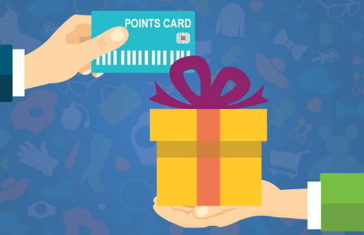
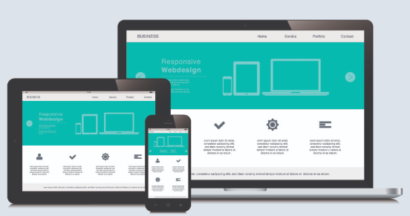

Recommendation: Loyalty Program
Loyalty Cards
Versatile; Apple e-wallet and Google Pay
Also offered in traditional ways (physical loyalty cards)
Website Revamp
Rewards program page for FAQs and general knowledge
Rewards App
Social Media Marketing
Leveraging Twitter to promote The Source loyalty program

Slide 5
Recommendation – Loyalty Program: Points System
Loyalty Cards
Basic Member
2500 points is $5
1% return
Premium
Member
Spends $1,500 in the calendar year
2% return
Physical card & e-card offered
2 sign-up options:
Online – no discount
In-store – 10% discount on next purchase
Points program:
Basic – 5 points per dollar
Premium – 10 points per dollar
Monthly rotational redeemable products

Slide 6
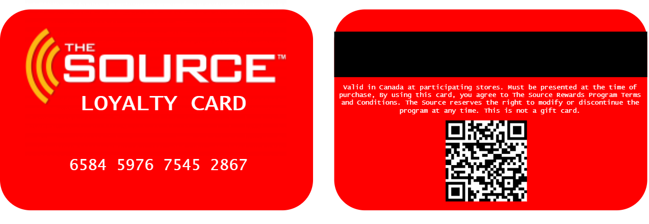
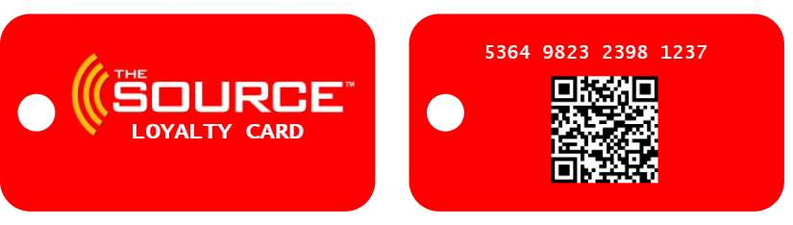
Recommendation – Loyalty Program: Cards

Slide 7
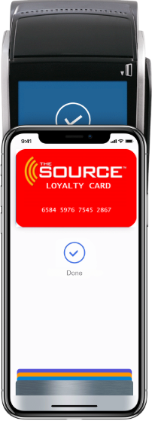
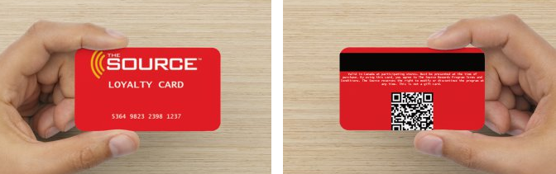
Recommendation – Loyalty Program: Cards

Slide 8
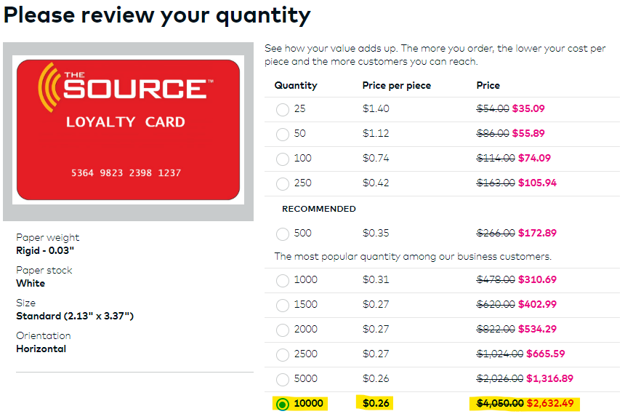
Costs
Notes:
Source: Vista Print
Source: Plastic Resource

Slide 9
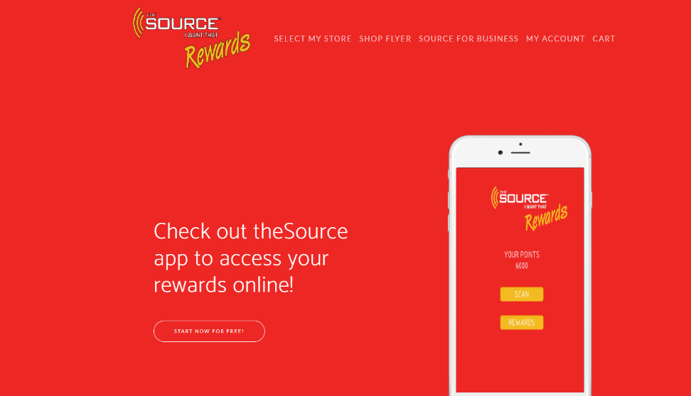
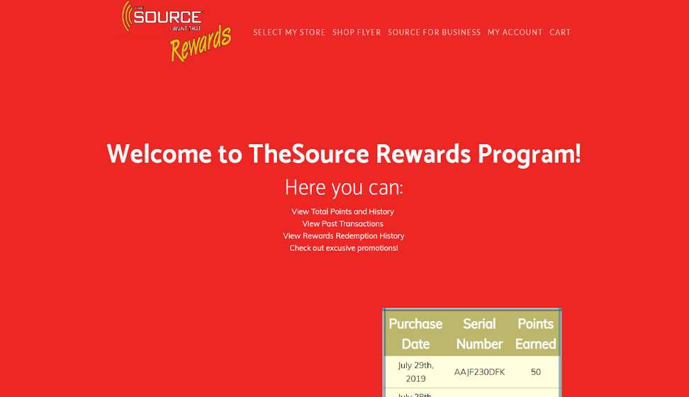
Recommendation – Loyalty Program: Website Revamp
Non - Authenticated
Authenticated
Notes:
Hyperlink: Non-Authenticated

Slide 10
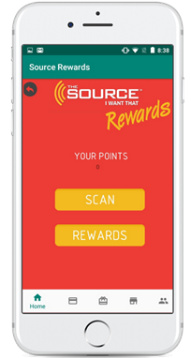
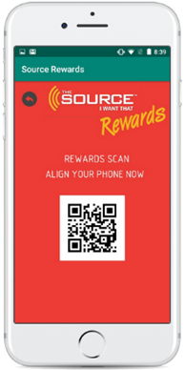
Recommendation – Loyalty Program: Rewards App
The Source Rewards App
Basic app to redeem points for gift cards, products, merchandise and more
Includes:
Points tracker
QR Code scanner to receive points on every purchase
Compatible with Android and Apple devices
Video Demo
Notes:
Hyperlink: Video Demo

Slide 11
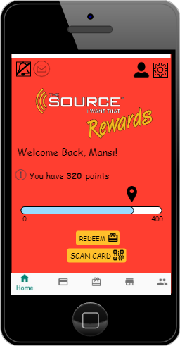
Recommendation – Loyalty Program: Rewards App
The Source Rewards App
Enhanced app which can be leveraged in the future
Net new functionality:
Points dashboard & tracker
Ordering rewards online
Support Page integrated with bot
Notifications
Settings
Overall enhancements

Slide 12
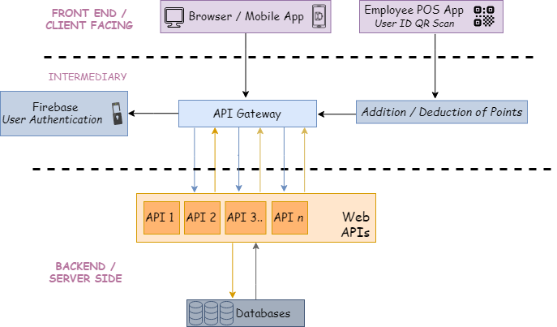
Rewards Program Architecture

Slide 13



Costs
Rewards App & Website Revamp
Database
Firebase
Bell servers/database in the future
Initial: 170k (Source: IT infrastructure)
Initial Development
Onshore: 539k (Includes IT delivery, business, design, development, testing)
Offshore: 282k (Outsourced to a vendor; includes IT delivery development + testing)
Chat-bot Integration: ~50k
Maintenance Costs
Database: 60k (Source: IT infrastructure)
Development: 174k (20% of initial development costs)
Publishing costs
iOS (per year): $99
Android (one time): $25
Total (Initial): 991k

Slide 14
Recommendation – Loyalty Program: Social Media Marketing
Increase social media presence
Focus on Twitter as it accurately addresses the Source’s demographic for customers
40% of Twitter users are 18-29 years
27% of Twitter users are 30-49 years
Twitter will be used to:
Promote/support the Loyalty program
Promote new in-store deals through hashtags
Encourage customers interaction

Slide 15
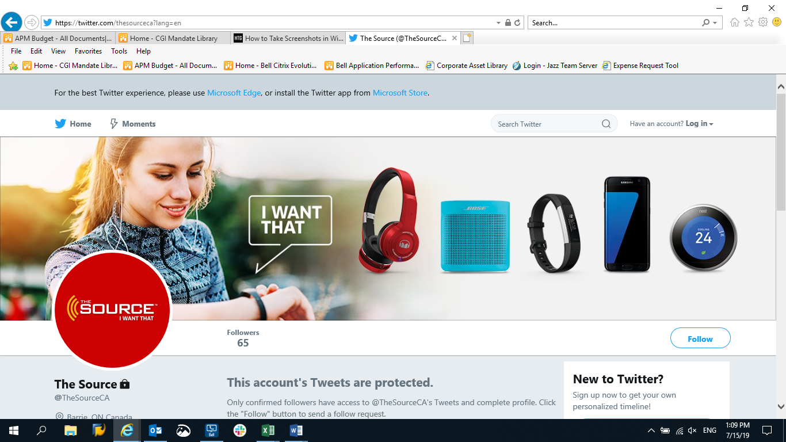
Recommendation – Loyalty Program: Twitter Marketing

Slide 16
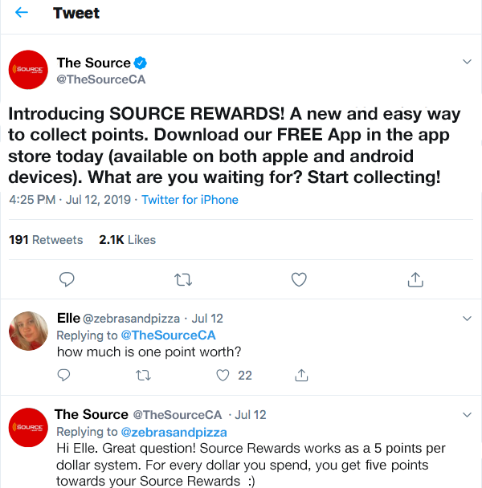
Recommendation – Loyalty Program: Twitter Marketing
Promoting & Supporting the Loyalty Program

Slide 17
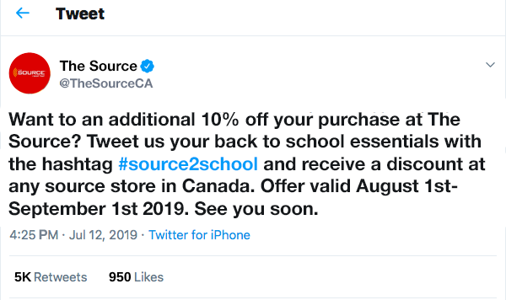
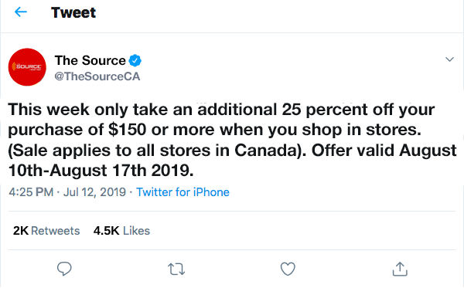
Recommendation – Loyalty Program: Twitter Marketing
Promoting New In-Store Deals

Slide 18
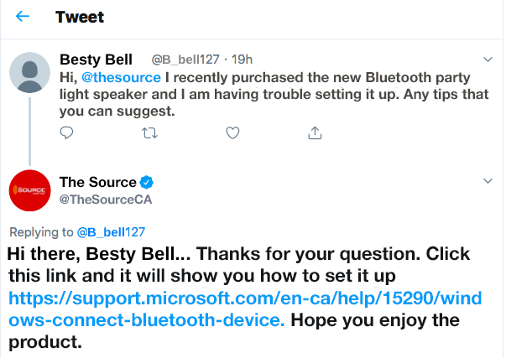
Recommendation – Loyalty Program: Twitter Marketing
Encouraging Customer Interaction

Slide 19

Costs
Social Media Marketing: Twitter
Option 1: Hire a Marketing / Public Relations Intern for the summer to manage the account (temporary solution)
Estimated Cost: ~$20/hour on a contract or part-time basis
Option 2: Hire a full time Marketing/Public Relations employee (permanent solution – more feasible)
Estimated cost: 50k-70k per annum

Slide 20
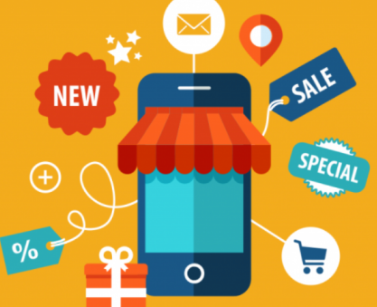
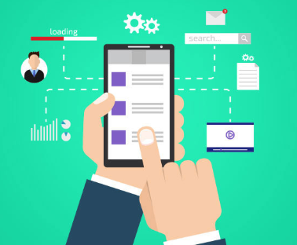

Risk Mitigation
Customer facing implies a considerable amount of customer interaction
Understand the customer
Don’t offer a solution for a problem that doesn’t exist
Sell the customer a better experience
Change the point system based on feedback from customers
Same number of points offered, but rewards redemption will decrease
More Promotional offers and seasonal discounts
Beta Testing for feedback on the apps and web flows

Slide 21
Implementation Timeline
The Source Loyalty Program
Q1 2020
Q2 2020
Q3 2020
Q4 2020
Q1 2021
Q2 2021
Q3 2021
Q4 2021
Plan
Ongoing Maintenance: Feedback Updates, Bug Fixes, OS Upgrades
Project Approvals
Requirements, Design & Analysis for App + WFE
1
2
S1
S3
S5
S7
S9..
Sn
Buffer Period
Website Revamp
Ongoing Social Media Marketing, Promo & PR
BHM Rollout
M2 Rollout
M3… Rollout
Launching loyalty cards market-by-market
App Development, Testing & Releases done in Sprint Cycles
1
Early MVP Launch (basic app)
2
Fully Enhanced App Launch

Slide 22
Conclusion
Overall Recommendation:
Implement a loyalty program which will boost profits by over 25%
Increased customer reach and store traffic
Improved business-to-customer relationship
Increased conversion rates
Leverage social media accounts to promote the program and The Source products
Increases in-store sales and frequency of customer purchases by 90%
Enhance digital user experience through the app and website
Initial Costs
Recommendation Aspect | Approximate Cost ($)
App Dev + Website Revamp | 990,950
Physical Cards (10,000) | 2,632.49
Key Tags (10,000) | 1,900
Total | 995,482.49
OGS Costs (Annually)
Recommendation Aspect | Approximate Cost ($)
App + Web Maintenance | 234,099
Social Media Marketing + PR (Option 2 Average) | 60,000
Total | 294,099

